Slide 1




DATA MINING BSCS 4-2
POP-IFY: SONG POPULARITY PREDICTION USING DECISION TREE REGRESSION
Cabana • Camarillo • Dingcon • Macapagal • Satur • Verendia
Start Slide

Slide 2
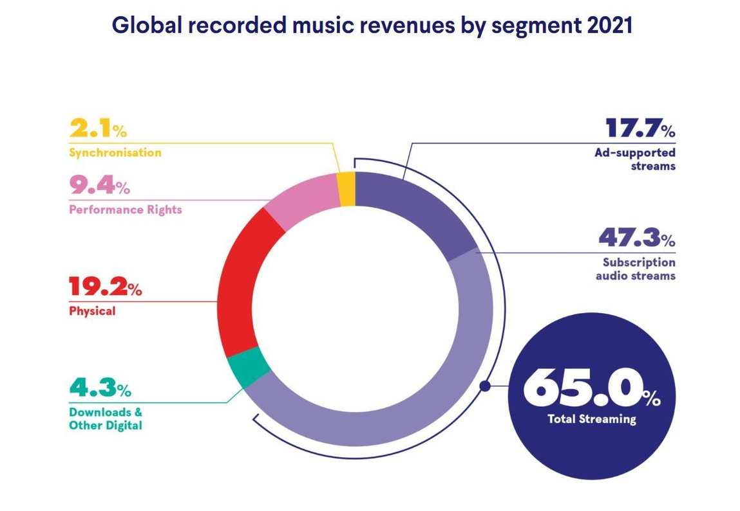
INTRODUCTION
BACKGROUND
Global music revenues continues to grow, driven by a surge in streaming which accounted for 65% of the industry's revenues.
-International Federation of the Phonographic Industry
Notes:
The first part of the presentation is the background.
The topic revolves around music. And who doesn’t like music? The current generation is very active in streaming songs online.
Due to this surge in online music streaming, like spotify, global music revenues almost rose up to 20% last year,, accounting to a 65% industry revenue.
And it is very well-known in the entertainment industry that topping the music charts is what place your company in the lead among other competitors.

Slide 3

INTRODUCTION
BACKGROUND
Utilizing data mining on historical music charts to gain insights on current trends can provide competitive advantage
Notes:
And since there tons of music-related data out there, one can opt to take advantage of high-charting song data in order to produce same quality products.
So we utilize data mining on historical music charts to gain insights on trends that possibly give competitive advantage

Slide 4
INTRODUCTION
THIS PROJECT AIMS TO:
Investigate the possibility of predicting the popularity of a song by identifying the impact of a song's audio elements
Create an app that predicts a user-provided song's popularity and the option to retrain the model
Notes:
This project aims to investigate the possibility of predicting the popularity of a song through its audio elements.
And to create an app or software that predicts song popularity and is able trained during run time

Slide 5



INTRODUCTION
OBJECTIVES
Test performance using MSE & RMSE evaluation metrics
Implement Decision Tree Regression
Perform Exploratory Data Analysis (EDA)

Slide 6

LITERATURE REVIEW
Song Popularity
Essa et al. (2022)
Kyauk et al. (2015)
Performed Exploratory Data Analysis and compared models using classification, regression, and ensemble learning.
The Decision Tree regressor yielded RMSE values of 7.88407 and 8.30137 for the train and test data, respectively.
Applied regression and classification on the popular dataset, The Million Song Dataset, with songs up to 2011.
Made use of Echo Nest’s social field known as "song hotttnesss" for the popularity metric.

Slide 7
LITERATURE REVIEW
Prediction using Decision Tree Regression
Brunda et al. (2020)
Karim et al. (2021)
Applied Decision Tree Regression and Random Forest to predict crop price and indirectly estimate the profit for given crops before sowing
The results show that the Random Forest Regression and Decision Tree Regressor has the best prediction model among all with an accuracy of around 99%.
Linear Regression and Decision Tree Regression are applied for different sizes of a dataset for revealing the stock price forecast prediction accuracy

Slide 8
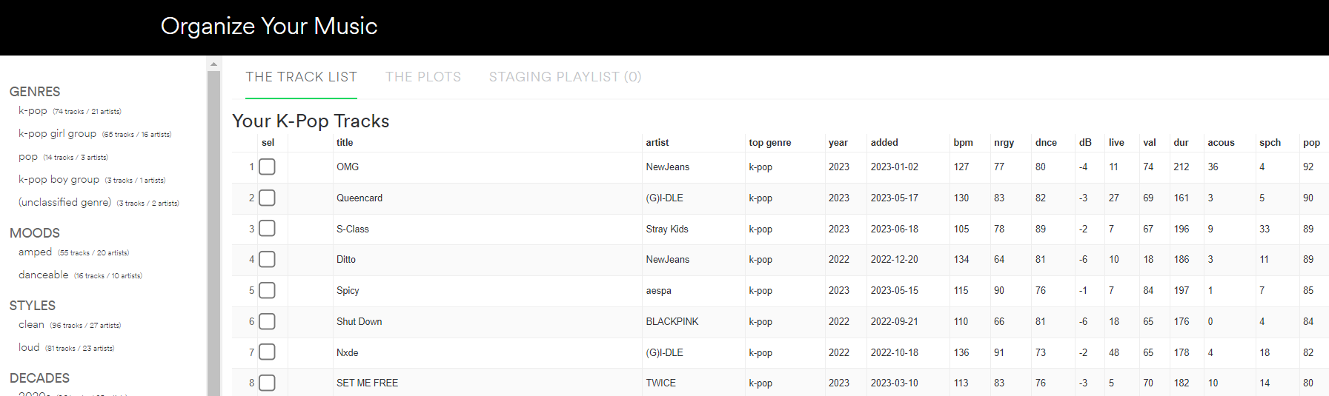
DATA SOURCE
Spotify Past Decades Songs Attributes from Kaggle
consists of popular songs from Spotify's "All Out" playlists per decade, from the 1950s to the 2010s
a total of 667 records and 15 attributes
Web scraping of Spotify's All Out 2020s playlist
utilized the “Organize Your Music” website
a total of 144 songs were collected

Slide 9
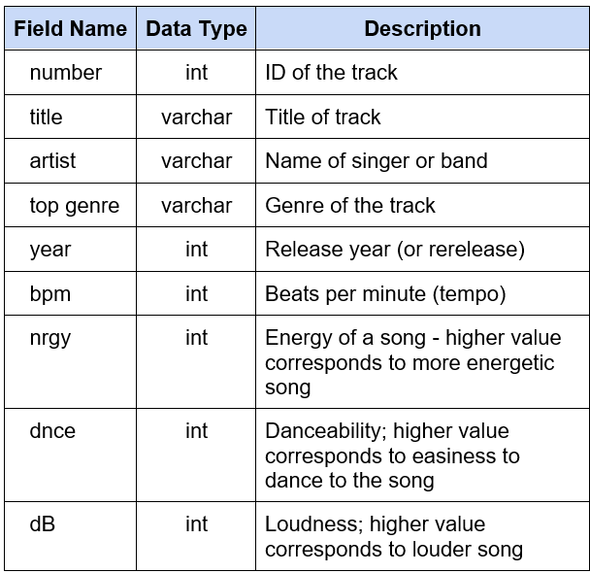
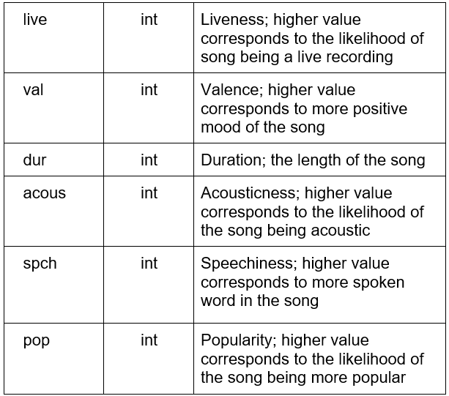
DATA SOURCE - METADATA

Slide 10
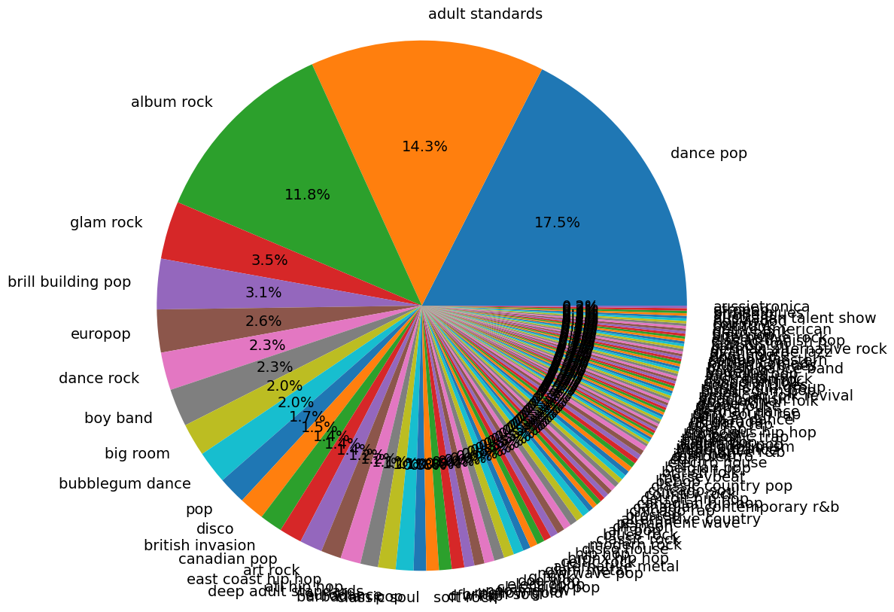
EDA - GENRE ANALYSIS - PIE CHART
The top three genres are dance pop with 17.5%, adult standards with 14.3%, and album rock with 11.8%. The remaining 112 genres build up 56.4% of the dataset.
Exploratory Data Analysis using Spotify's “All Out” playlists per decade, from the 1950s up to 2020s.

Slide 11
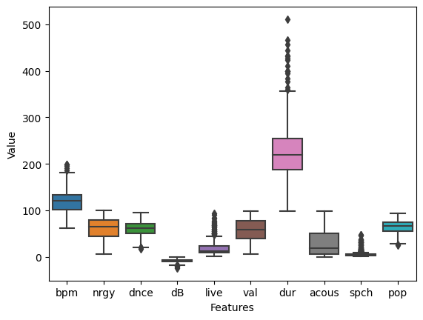
EDA - OULIER ANALYSIS - BOXPLOT
bpm - beats per minute
nrgy - energy
dnce - danceability
dB - loudness
live - liveliness
val - valence, mood of the song
dur - duration
acous - acousticness
spch - speechiness
pop - popularity
Exploratory Data Analysis using Spotify's “All Out” playlists per decade, from the 1950s up to 2020s.

Slide 12
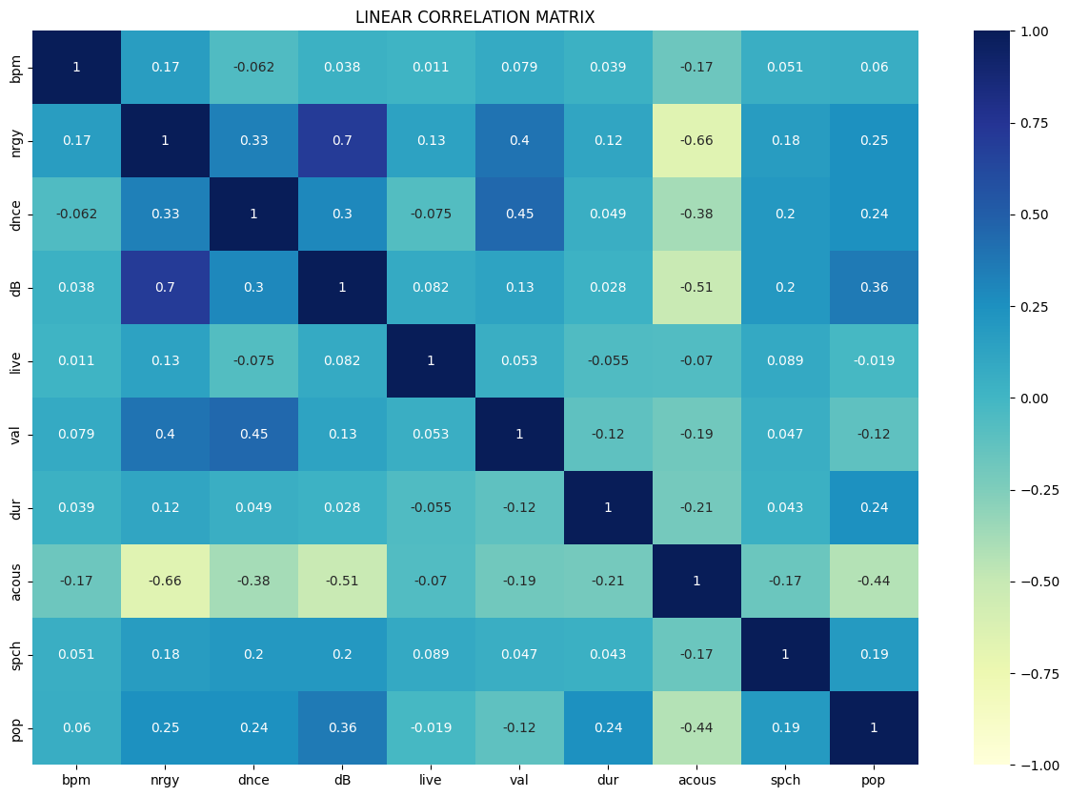
EDA - CORRELATION MATRIX - HEATMAP
High energy = the song is louder
High valence = higher energy and is more danceable
High acousticness = lower energy, less loud, less danceable, and less popular
Exploratory Data Analysis using Spotify's “All Out” playlists per decade, from the 1950s up to 2020s.

Slide 13
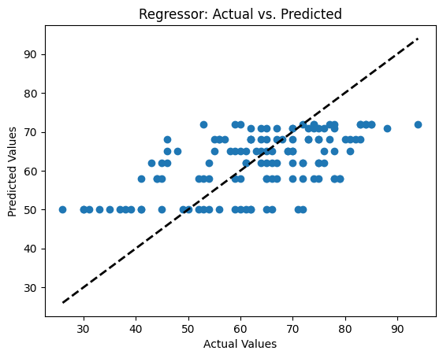
MODEL EVALUATION
The decision tree regressor model has an MSE of 128.58 and an RMSE of 11.34.
The training and testing scores are 32.49% and 34.12%, respectively.

Slide 14
FINDINGS
The top three genres are "dance pop," "adult standards," and "album rock," with 17.5%, 14.3%, and 11.8%, respectively.
The "duration" attribute had the most outliers, followed by "liveness" and "speechiness."
The "energy" feature yielded the highest correlation value of 0.7 when compared to "loudness". On the other hand, the "acousticness" feature has negative correlation values with respect to other features.

Slide 15
FINDINGS
The "popularity" attribute has a correlation value of 0.36 with the "loudness" attribute. And has a negative correlation with "liveness" and "acousticness."
The top three features that directly influence the "popularity" of the song are: "year," "duration," and "acousticness."
In ascending order, the trained model’s predicted values are 50, 58, 62, 65, 68, 71, and 72.
The decision tree regressor model has an MSE of 128.58 and an RMSE of 11.34. The training and testing scores are 32.49% and 34.12%, respectively.

Slide 16
CONCLUSION
The dataset's limitations include a lack of sufficient records for most features, compromising the model's training and prediction performance.
The analysis was hindered by the limited occurrences of genres other than "dance pop," "adult standards," and "album rock.“
The target variable, "popularity," exhibits weak correlations with other features, making accurate predictions challenging.
Notes:
Finally, we came up with the following conclusions
That the dataset is insufficient considering the number of features added after one-hot encoding implementation, which compromised the model’s training and predictive performance.
And in the second bullet we can see that only three out of 115 genre features have sufficient records, namely the “dance pop,” “adult standards” and “album rock”
Next. We concluded a generally weak correlation between predictors and the target variable, which makes predictions challenging.
And although “year,’ “duration,” and “acousticness” falls within the top influentials features, other features were not removed due to its minimal impact on the model’s performance

Slide 17
CONCLUSION
"Year," "duration," and "acousticness" have been identified as influential factors for "popularity," while removing other features had minimal impact on the model's performance.
The decision tree regressor model shows large errors in train and test data, indicating underfitting.
Notes:
And although “year,’ “duration,” and “acousticness” falls within the top influentials features, other features were not removed due to its minimal impact on the model’s performance
Next, we concluded that the model is undefitting; as seen in the large errors in train and test data

Slide 18
DATA MINING BSCS 4-2
POP-IFY: SONG POPULARITY PREDICTION USING DECISION TREE REGRESSION
THANK YOU!
Cabana • Camarillo • Dingcon • Macapagal • Satur • Verendia

